Slide 1
B trees(Balanced tree)
One node contain more than one element
So height is very low . Nodes are in same level

Slide 2
Properties of B tree
Balanced m-way tree .
Generalization of BST in which a node can have more than one key and more than 2 children .
All leaf nodes will be in the same level .
Notes:
Insert a map of your country.

Slide 3
concept
In most of the other self-balancing search trees (like AVL and Red-Black Trees), it is assumed that everything is in main memory
To understand the use of B-Trees, we must think of the huge amount of data that cannot fit in main memory.
Notes:
Insert a map of your country.

Slide 4
When the number of keys is high, the data is read from disk in the form of blocks.
Disk access time is very high compared to the main memory access time.
The main idea of using B-Trees is to reduce the number of disk accesses.
Notes:
Insert a map of your country.

Slide 5
The height of B-Trees is kept low by putting maximum possible keys in a B-Tree node.
Generally, the B-Tree node size is kept equal to the disk block size.
Since the height of the B-tree is low so total disk accesses for most of the operations are reduced significantly compared to balanced Binary Search Trees like AVL Tree, Red-Black Tree, ..etc.
Notes:
Insert a map of your country.

Slide 6
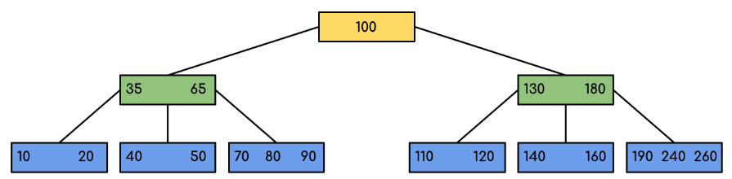
Notes:
Insert a map of your country.

Slide 7
Properties of B-Tree
For balancing the tree each node should contain n/2 keys. So the B tree of order n can be defined as:
All leaf nodes should be at same level.
All leaf nodes can contain maximum n-1 keys.
The root has at least two children.
The maximum number of children should be n and each node can contain k keys. Where, k<=n-1.
Notes:
Insert a map of your country.

Slide 8
Each node has at least n/2 and maximum n nonempty children.
Keys in the non-leaf node will divide the left and right sub-tree where the value of left subtree keys will be less and value of right subtree keys will be more than that particular key.
Notes:
Insert a map of your country.

Slide 9
Example: Searching 120 in the given B-Tree
Notes:
Insert a map of your country.

Slide 10
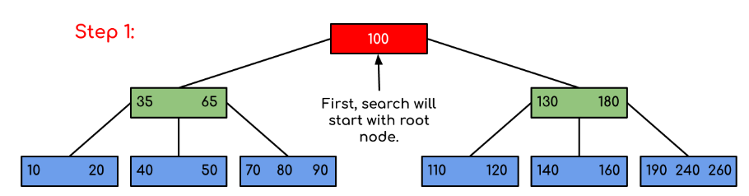
Notes:
Insert a map of your country.

Slide 11
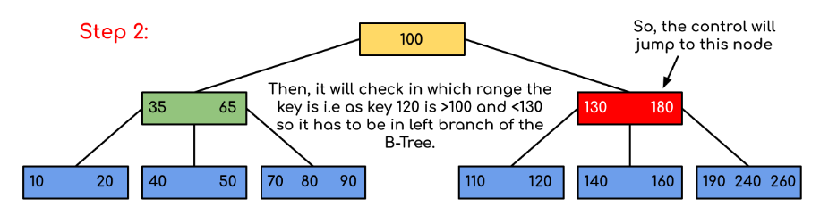
Notes:
Insert a map of your country.

Slide 12
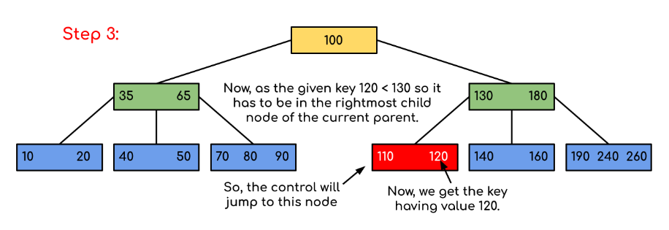
You can see that our search was reduced by just limiting the chances where the key containing the value could be present.
Notes:
Insert a map of your country.

Slide 13
Traversal in B-Tree
Traversal is similar to Inorder traversal of Binary Tree.
We start from the leftmost child, recursively print the leftmost child, then repeat the same process for remaining children and keys.
In the end, recursively print the rightmost child.
Notes:
Insert a map of your country.

Slide 14
B-Tree of order 4
Maximum elemnts( keys )hold by any node is 3 only
5 , 3 , 21 , 9 ,1 , 13 , 2 , 7 ,10 , 12 ,4 , 8
Notes:
Insert a map of your country.

Slide 15
2-3 tree
Create B-tree of order 3 by inserting values from 1-10

